Slide 1

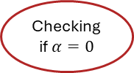
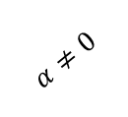
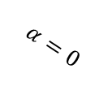
Parsing the input file
Memory allocation
Initialization
Loop of steps
Output solution
Convergence test
Zeroing A, B, C, D vectors
Freeing the allocated memory
Advancing the solution
RHS
Calculating L2Norm
$$∆u_{i}=r⋅D_{i}$$
$$α=0$$
Inverting tri-diagonal matrix
Checking if $α=0$
Calculating L2Norm
LHS
$$α≠0$$
BC

